Slide 1
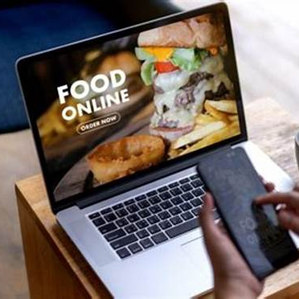
Customer Data Analysis
"Data Exploration and Key Findings“:
Age Distribution
Family Group Size Distribution
Strongest Distributor

Slide 2
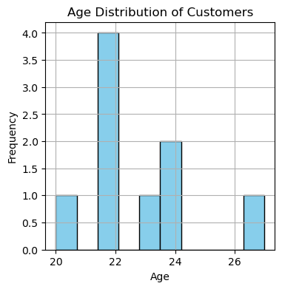
‘Age Distribution , Who are our customers?’
We're generating a histogram to visualize the distribution of ages among customers.
The insight we're interested in is understanding the age demographics of our customer base,
which can help us tailor marketing strategies and product offerings to specific age groups.

Slide 3
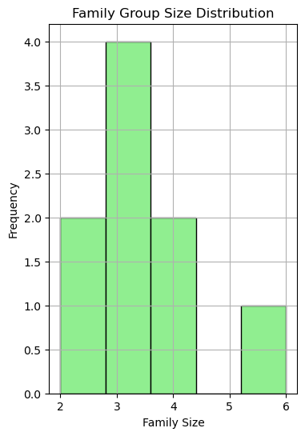
‘Comparing Family Group Sizes, household composition of customers’
Visualizing Family Group Size Distribution:
This histogram illustrates the distribution of family group sizes among our customer base.
Understanding the prevalent family sizes provides valuable insights for product development
and marketing strategies tailored to diverse family needs.

Slide 4
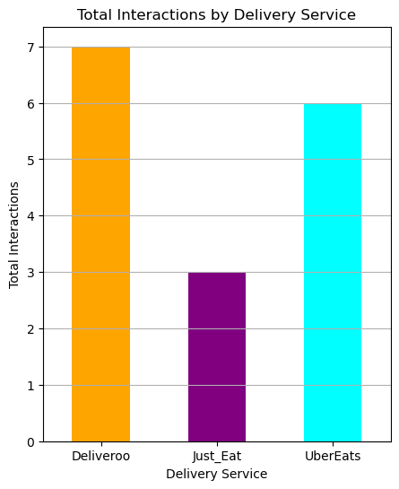
Analysis of Interactions with Delivery Services Customers' preferences for delivery services
Visualization of Strongest Distributor:
This graphic illustrates the total interactions for each delivery service,
including Deliveroo, Just Eat, and UberEats.
Analyzing these interactions helps identify the strongest distributor
based on customer engagement with each platform.

Slide 5

Summary of major findings or trends
. Distribution:
The age distribution of customers indicates that the majority of customers are in their early to mid-20s, with a mean age of approximately 22.6 years. Understanding this demographic can help tailor marketing, strategies and product offerings to appeal to this age group.
Family Group Size Distribution:
Analysis of family group sizes among customers reveals a diverse distribution, with a mean family size of approximately 3.44 individuals. This insight is valuable for developing products and services that cater to different family sizes within the customer base.
Strongest Distributor:
By analyzing the total interactions for each delivery service, we found that Deliveroo has , the highest engagement among customers, followed by UberEats and Just Eat. This information , can guide decisions on resource allocation and partnership strategies with delivery services.
Prediction:
Based on the insights gathered from the analysis, we predict continued growth in customer engagement , and expansion opportunities in areas with high customer density. By leveraging demographic insights , and delivery service preferences, the business can optimize marketing strategies and enhance service offerings.

